Slide 1
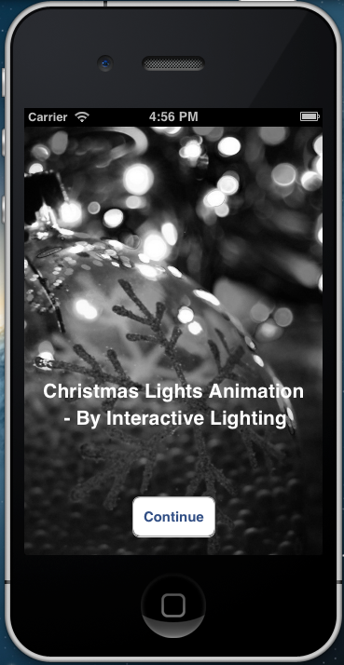
Christmas Lights Animation
By Interactive Lighting
By:
Austin Wentz and Jordan Doell

Slide 2

Summary of project:
Christmas Lights Animation
Sponsor - L3 Communications
Description - Christmas lights synced to music and controlled via an iPhone

Slide 3
Analysis:
Christmas Lights Animation
Analysis
Sprints
Live Demo
Use SSR’s to power lights on and off
Laptop running XBMC, connected to a separate controller
Connect controller to SSR’s
Develop an iPhone app that can connect to the system from any wireless location

Slide 4
Sprint 4:
Christmas Lights Animation
Analysis
Sprints
Live Demo
Sprint 4
Sprint 5
Backlog
Configure EC2 server to act as middleman between iPhone app and Christmas lights
Develop RESTful web service to allow iPhone to send commands and Raspberry Pi to get commands
Begin connecting iOS framework to UI

Slide 5
“Middleman” Server
Amazon EC2 instance running Ubuntu
Mobile device sends notifications or requests to the EC2 server.
Computer connected to lighting controller queries EC2 instance for new information.
Prevents having any issues with firewalls, network configuration, etc.

Slide 6
Sprint 5:
Christmas Lights Animation
Analysis
Sprints
Live Demo
Sprint 4
Sprint 5
Backlog
Implement XBMC plugin for client
Refine RESTful web service on EC2 server
Reworked app interface
Send JSON from iPhone to server

Slide 7
Why XBMC?
Award-winning open source (GPL) media center software.
Works on Linux, OSX, & Windows
Can be installed on Raspberry Pi
Designed for network playback and supports almost all audio and video formats
Includes a built-in Python interpreter which allows users to develop add-ons
www.xbmc.org for more information about XBMC

Slide 8

XBMC Demonstration

Slide 9
Our XBMC Add-on
XBMC already has all the media playback functionality we need
Created an add-on which adds ability to control lights manually or at the song level.

Slide 10
Backlog:
Christmas Lights Animation
Analysis
Sprints
Live Demo
Sprint 4
Sprint 5
Backlog
Test web service
Test client code
Test iOS App

Slide 11

Live Demo!
Christmas Lights Animation
Analysis
Sprints
Live Demo

Slide 12

Questions?
Christmas Lights Animation

